Slide 1
Dell Hackathon Indian Sign Language Localisation
-Team 10

Slide 2
The problem
Deaf and mute people make up a significant portion of the Indian populus
Only about 0.1% of the population is certified and able to converse in sign language
Conversation and daily life of the deaf is thus extremely challenging and they are unable to complete the generally simple tasks of life

Slide 3
Is there a solution?
There are 2 main parts of the problem-
Converting Sign Language to text
Converting text to sign language
Converting Both problems are vastly different and require different implementations

Slide 4
1) Isl to text
Since the majority does not understand ISL, we require a program that can successfully convert the gestures into their respectful meanings
This can then simply be read by the user, allowing for general understanding of the user

Slide 5
Challenges in implementing a solution
Creating a program that can recognise Indian sign language gestures and convert them to text in real time
Requires a lot of data to train the respective model
ISL is not well structured compared to other sign language

Slide 6
Solution 1
A simple model is created following a RandomForest Classifier
The model is given basic data of letters and numbers
Accuracy is not very high

Slide 7
Improving solution 1
Due to low accuracy, more preprocessing was required to improve the performance
Classification is now done in batches and clusters
KNN is used to group different instances of the same gesture
Accuracy is improved but not as expected

Slide 8
Solution 2
Model is now shifted from a simple machine learning model to an RNN
LSTM is implemented for better processing of letters and strings
Accuracy is improved considerably

Slide 9
Working
Final Detection
(Application.py)
ISL
USER
Gives Input
GESTURE
OUTPUT
Process1
(Function.py)
Process2
(Data.py)
Process 3
(Train_model.py)
Capturing data
(Data collection.py)
MP_Data

Slide 10
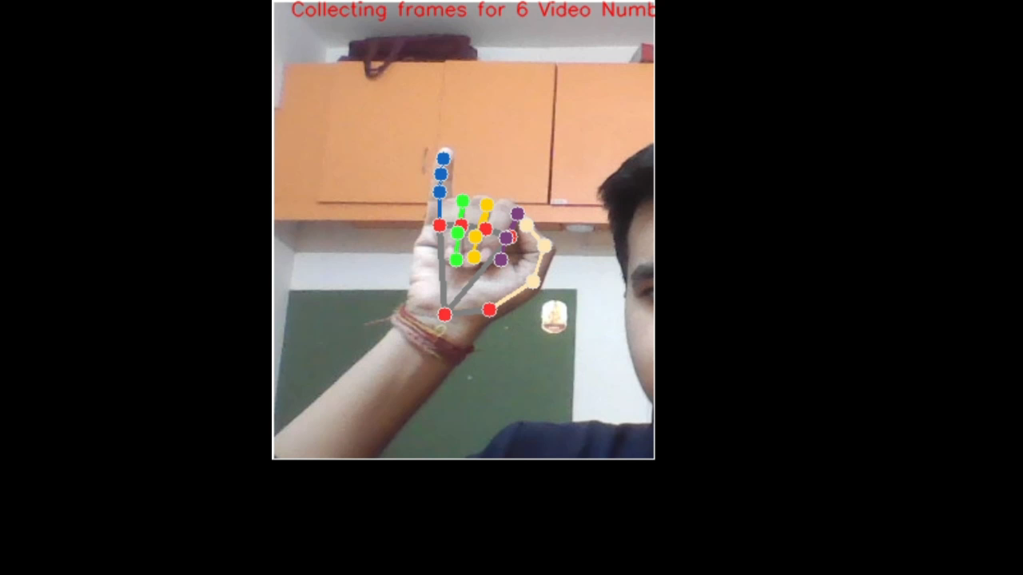
Working contd.

Slide 11
Limitations
Lack of data
Accuracy is not consistent
Process of training is very slow; lot of time is consumed
Generating real time output requires lot of processing power

Slide 12
2) Text to isl
While similar, converting written text into gestures requires a different approach and implementation
Written text needs to be converted into gestures which can be understood by the user conversing in the sign language

Slide 13
Challenges
Lot of image and text data is needed to create a model that can replicate the respective gesture
Converting text/strings into a form that is readable by the computer and producing the respective gesture

Slide 14
Initial Approach
Simple mapping of gestures to letters/numbers can be created
Rudimentary and not intuitive enough, not visually appealing
May or may not help in translation

Slide 15
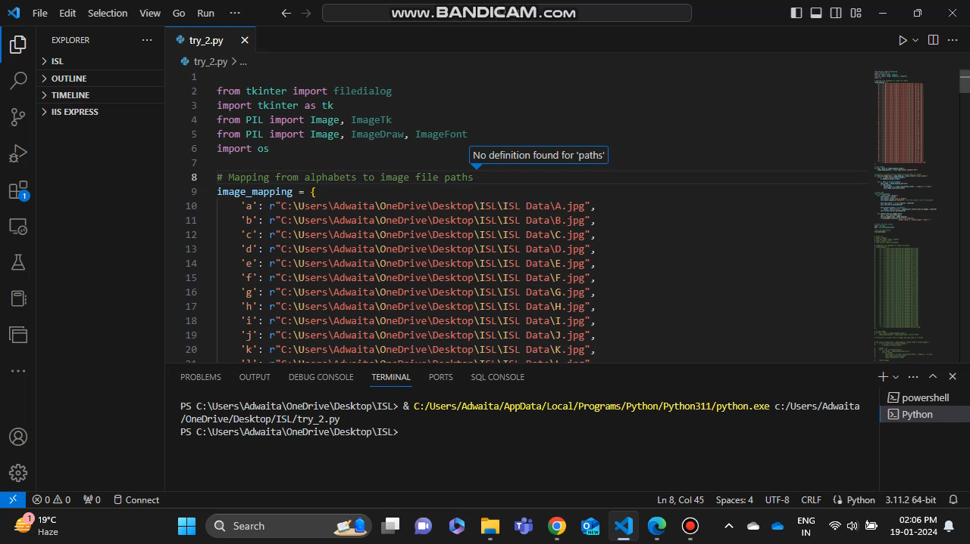
Initial Approach contd.

Slide 16
areas of Improvement
Gestures for words instead of splitting them letter by letter
Increasing size of inbuilt library
Improving quality and feasibility of output

Slide 17
Approach 2
Improving library size and culminating gestures paved a solution built on Deep Learning techniques
Training an RNN to recognise words built on ISL data and produce the respective output

Slide 18
Problems with approach 2
RNN requires a lot of textual data, while ISL data is mostly built on gestures and pictures
Lots of data is required
NLP processing and recognition of POS tagging was not accurate and resulted in incorrect output

Slide 19
Final approach
Existing gesture recognition libraries of Hamburg notation system is used for easier implementation
HamNoSyS symbols are combined with XML to create SigML(Signing gesture markup language) which is understood by 3D avatar softwares
Stanford Parser is used to integrate the library and improve the NLP tasks of sentence formation, POS Tagging, etc

Slide 20
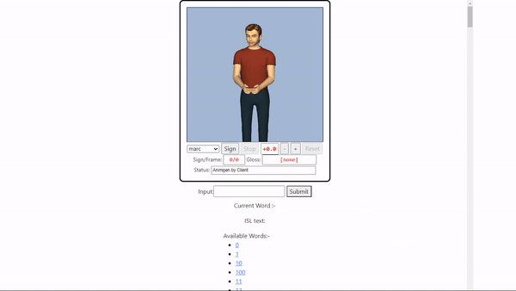
The solution

Slide 21
Solution contd.
The program can take any form of text/string input from the user, convert it into the respective sign language and display it in a seamless animation which is visually appealing and easier to understand.

Slide 22
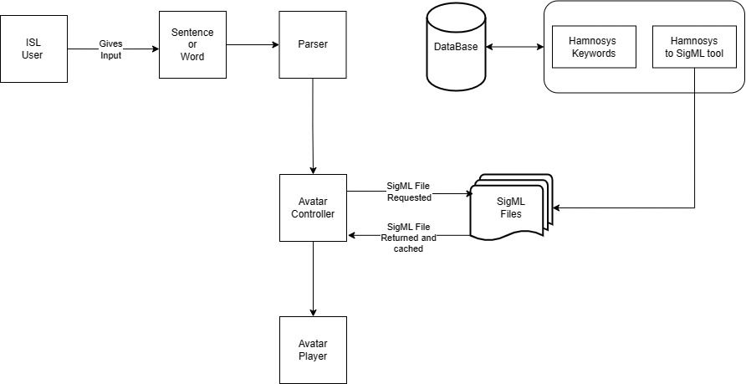
The working

Slide 23
Working contd.
Technologies used-
Python
Javascript, Flask
HamNoSyS Notation
SigML Representation and convertion
Stanford Parser
Basic NLP principles

Slide 24
Existing solutions and inspirations
The automation of sign language is a very popular area of research all over the world
TESSA, British Sign Language, 2002
ISLFromText.in, Thappar Institute, 2014

Slide 25
Future prospect
Creating a program that can overlay on a video of a person communicating in ISL and instantly translate the gestures into language of choice in real time, similar to live captions on a video
Wearable gloves which can translate hand movements into audio

Slide 26
Learning Log
2nd Nov – Selection of problem statement
6th Nov – Initial ideas for solutions are created
16th Nov – First meeting, exchange of ideas and splitting of work
17th Nov – Second approach is ideated, and a rough sketch is drawn out and machine learning is selected for better scale
30th Nov – Second meeting, team check point
8th Dec – Third meeting, teacher mentor suggests 3d modelling for output/more visually appealing output

Slide 27
Learning log contd.
10th Dec – Relevant research papers are found, new proof of concepts are created with the new information
14th Dec – Learning of HamNoSyS and SigML integration begins, third approach is created
20th Dec – Teachers and friends are requested for external help with JS, coffeescript and clean front end
8th Jan – Fourth meeting, 2nd team checkpoint
11th Jan – Coffeescript webGL avatar is used in tandem with SigML for 3d output
17th Jan – Final check meeting, projects are finalised
20th Jan – Presentation creation starts

Slide 28
References
https://www.researchgate.net/publication/306362600_HamNoSys_to_SiGML_Conversion_System_for_Sign_Language_Automation
https://vhg.cmp.uea.ac.uk/tech/jas/vhg2021/CWASA-legacy-gui-panel.html
https://nlp.stanford.edu/software/lex-parser.shtml
S. Prillwitz, R. Leven, H. Zienert, T. Hanke and J. Henning, HamNoSys Version 2.0: Hamburg Notation System for Sign Languages:An Introductory Guide, International Studies on Sign Language and Communication of the Deaf, Signum Press, Hamburg, Germany, vol. 5 (1) (PDF) HamNoSys to SiGML Conversion System for Sign Language Automation
An Intro to eSignEditor and HNS, Chapter 5 Representation of the Signs, Improvement and Expansion of a System for Translating Text toSign Language
https://vh.cmp.uea.ac.uk/index.php/CWA_Signing_Avatars

Slide 29
Empowering Communication

